Slide 1
Demo-Package Value based story telling demonstration for partners - Integration

Slide 2
Introduction
Value-based story telling demo-package
Goal of this demo-package:
Deliver to partners a global demonstration that covers our main integration use cases.
With one common company context (Business objectives & data challenges)
Use case approach:
Following your deep discovery with the customer, only demonstrate the relevant use cases
Partner presales demo review process:
Once deployed in the partner environment & enablement done to presales, the partner should:
Send a recording of the different use case demonstration to be reviewed by the PPM
Plan a live session (zoom or on-site) with his Partner Presales Manager (PPM)

Slide 3
Demo-package roadmap
 | # | Theme | Use-case | Showcase | Products
Included | 1 | Data warehouse Automation | Real-time Data ingestion – using CDC | Sourcing data from multiple sources, data transformation, creation of data mart, data product and analytics dashboard. | Qlik Talend Cloud Snowflake
 | 2 | Application Integration | Application Integration using messaging | Reading REST APIs, Pub-Sub messaging using Kafka | Talend Studio, API Designer / Tester, Kafka
Coming soon | 3 | AI-ready pipelines | Sentiment analysis (cortex or OpenAI)? | Working with vector databases and Large Language models.? | Talend Studio – with Pinecone and Cortex?
 | 4 | Data Quality | Pro-active and re-active data quality | Customer 360 (including DQ monitoring & Matching) | Data Prep, Steward & Studio
There will also be a Qlik dashboard available with each version.

Slide 4
Demo-Package Prerequisites
Skills requirement
Technical requirement
Ability to explain Qlik Talend Cloud value proposition
Qlik Sales Onboarding
Understand Qlik Talend Cloud applications
Complete Self-service training :
Use case 1:
Qlik Talend Cloud Data Integration Essentials
Use case 2:
Talend Studio for DI Essentials
Talend Studio for DI Advanced
Talend Cloud API Services
NFR Licence Qlik Talend Cloud Enterprise Edition
GitHub account
Docker desktop
Use case 1
Databases (MySQL, Postgres)
A Cloud database e.g. Snowflake
Use case 2
Messaging (Kafka)
Data movement Gateway Installed in your environment

Slide 5
An introduction to Qlik Data Integration
Demonstration of common use-cases

Slide 6
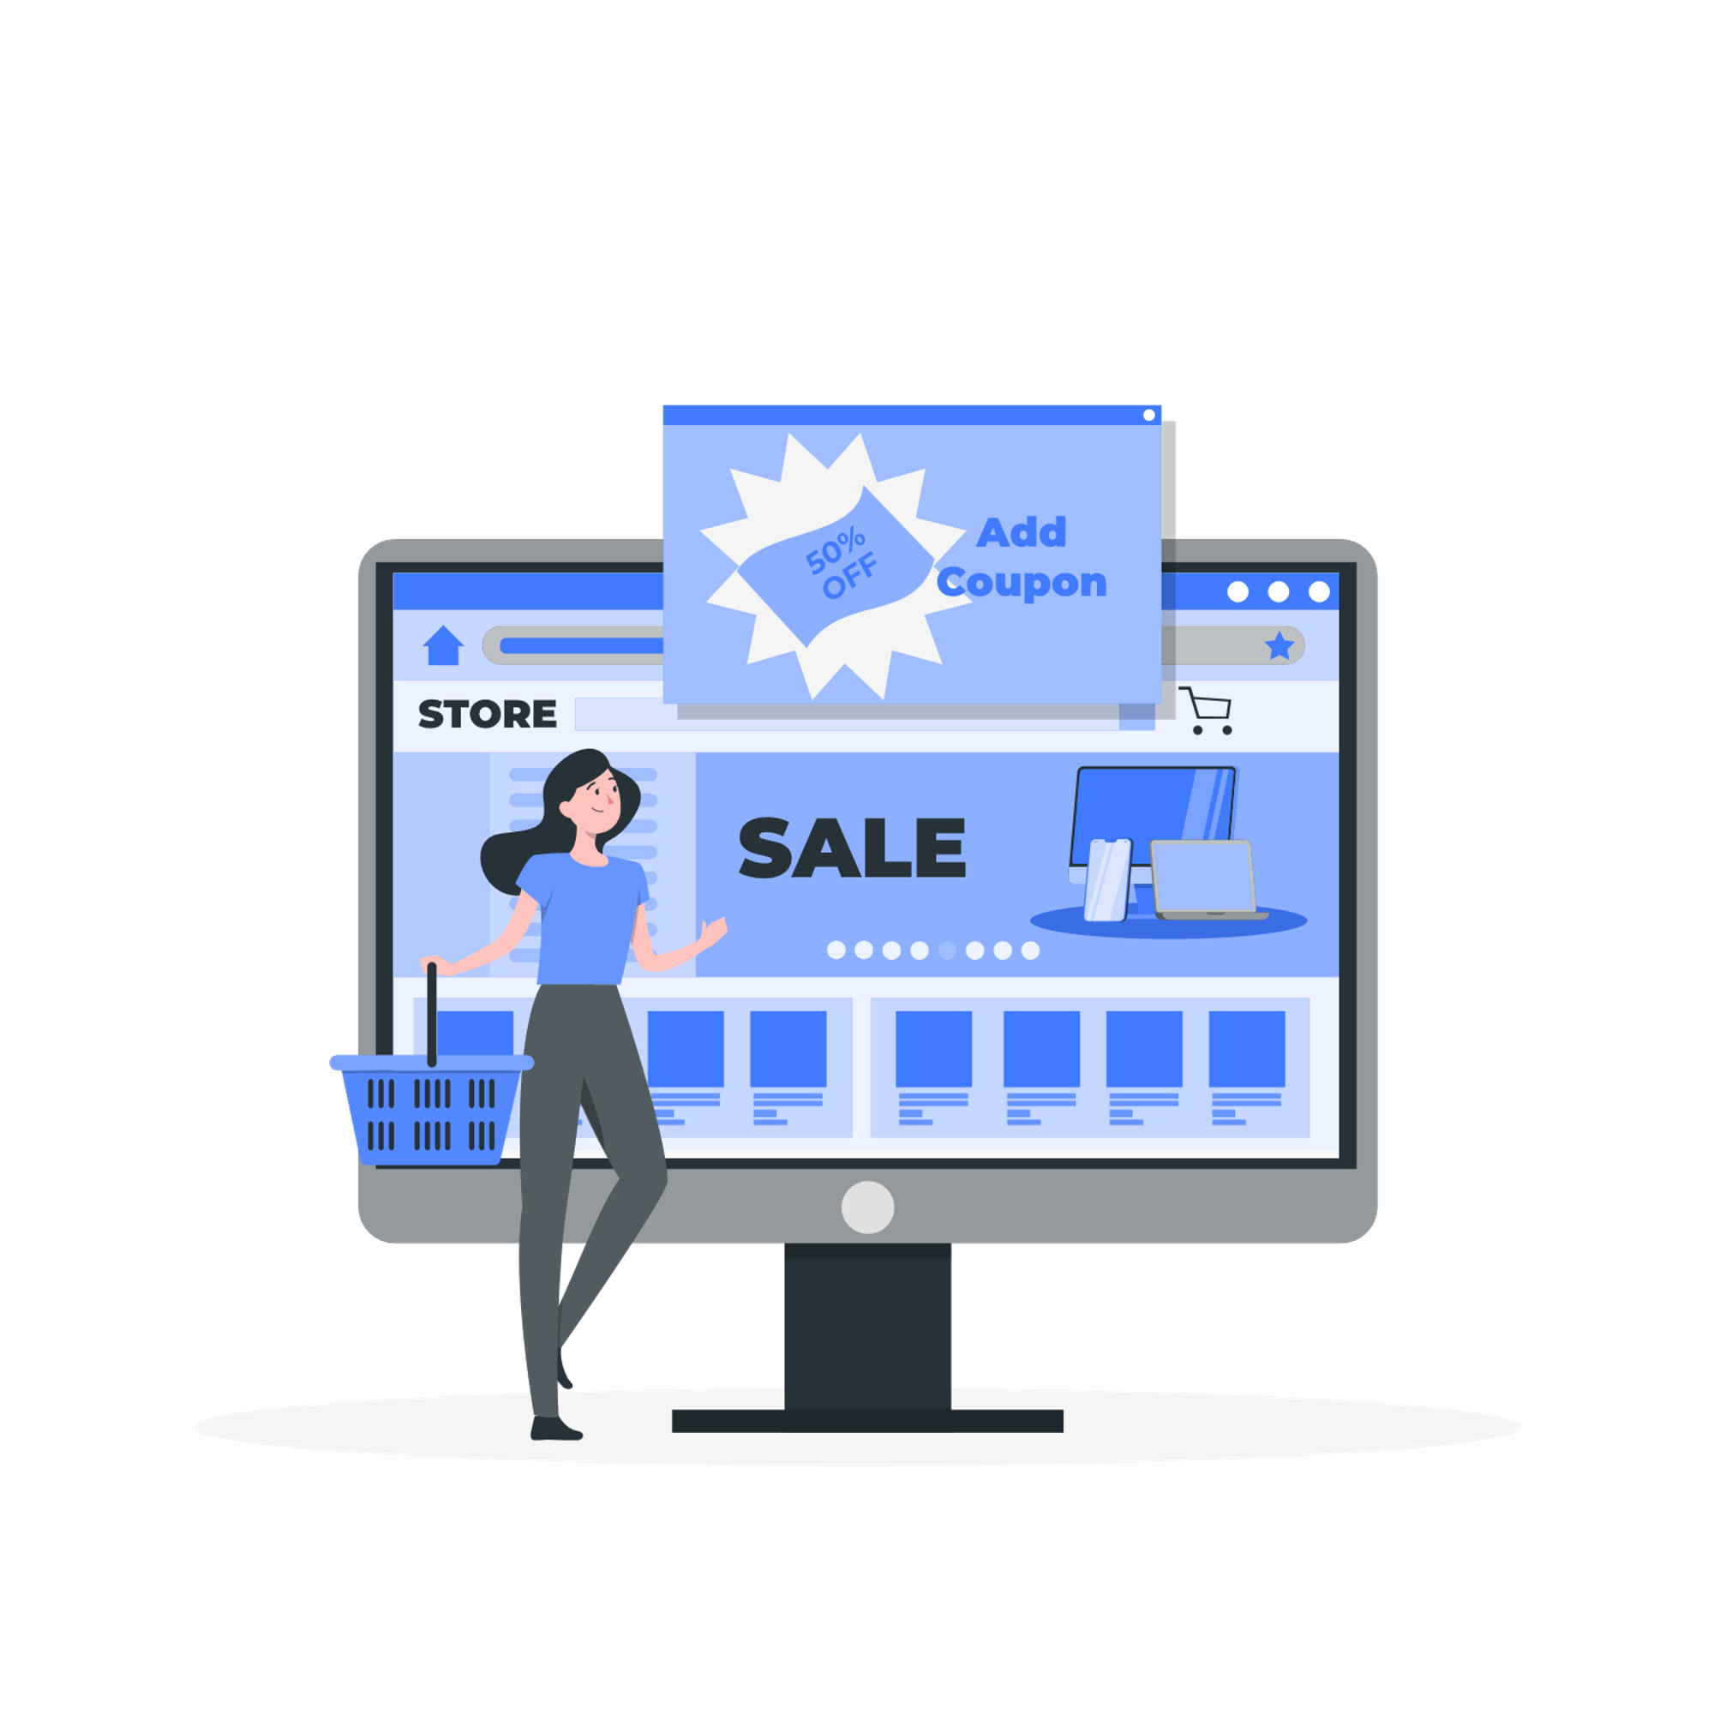

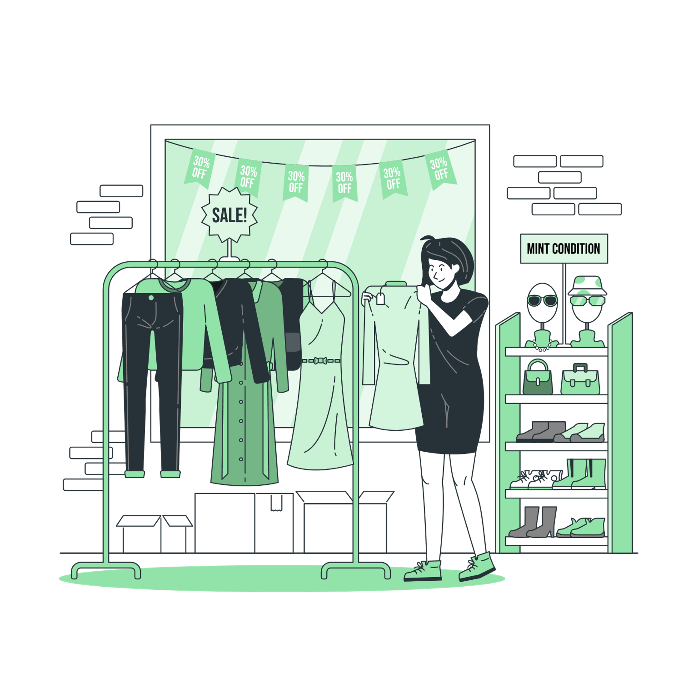


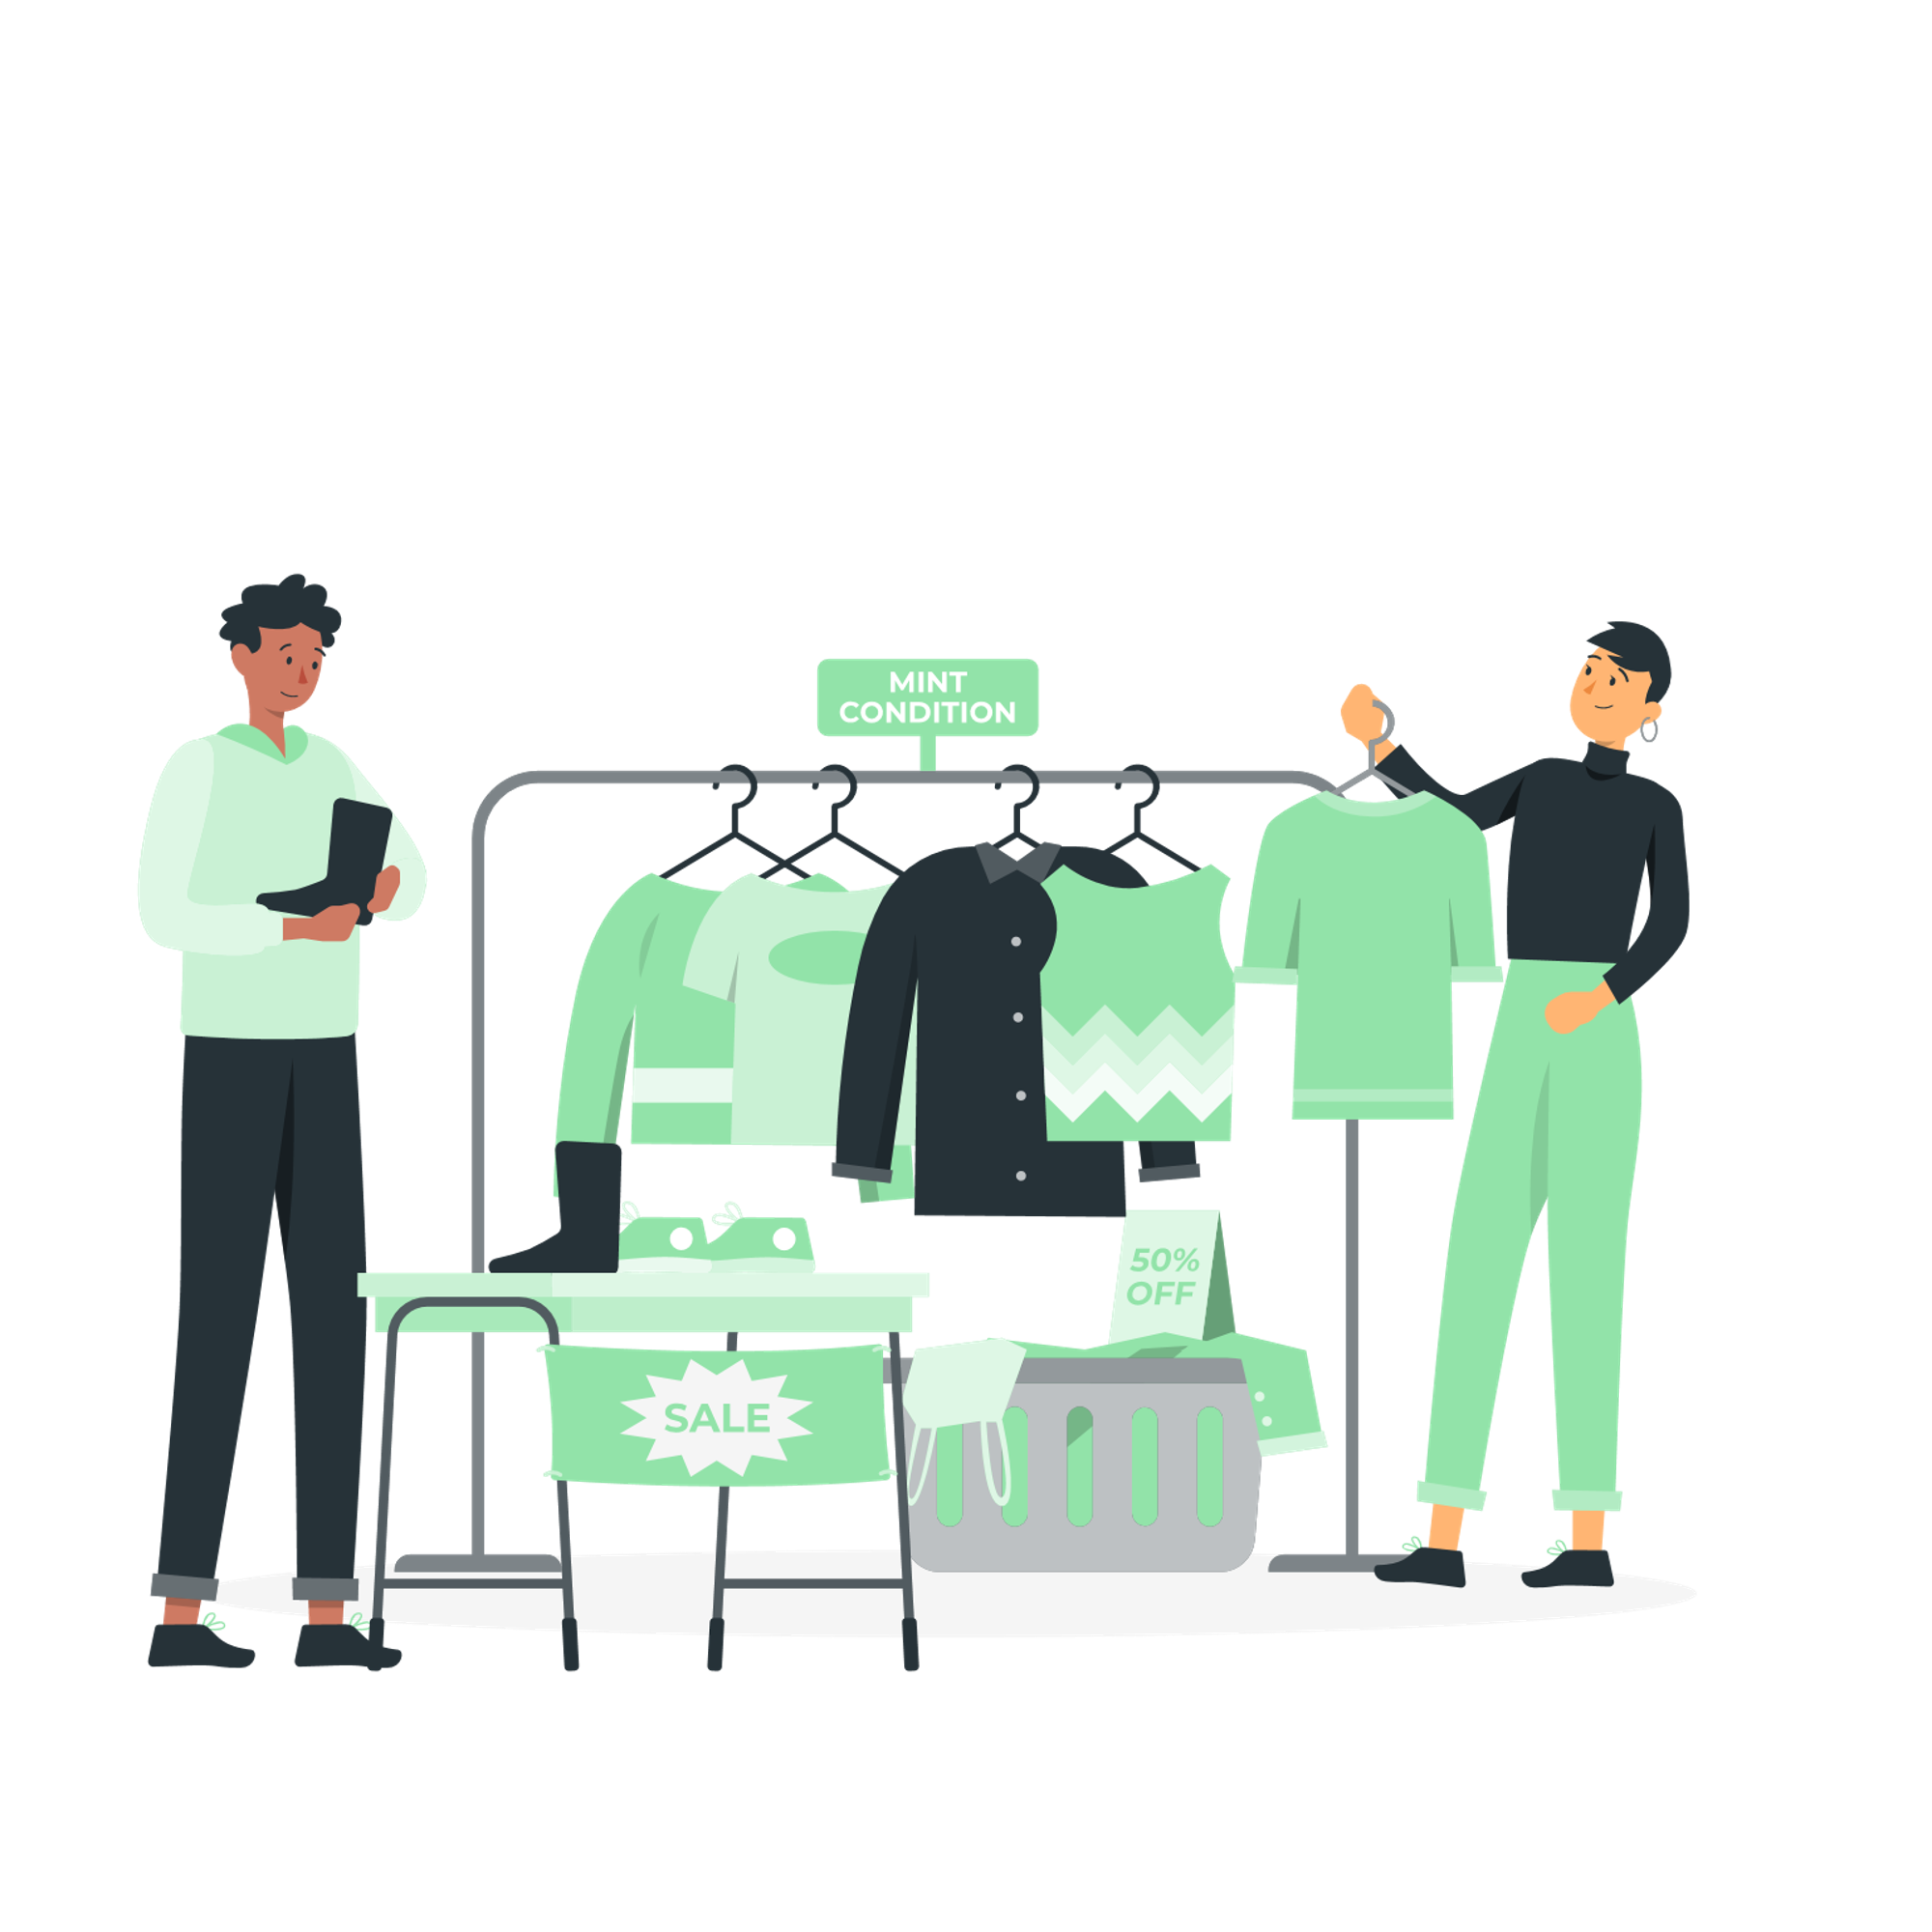
Global Customer context
Welcome to Manel – a multi-channel fashion retailing company, that sells their products in retail stores and on their e-commerce site.
Business Objectives
E-commerce
Collect and unify sales & customer data efficiently across channels to improve analytical reporting
Improve customer buying experience by providing Click-and-Collect services.
Website
London
Retail stores
Paris
Headquarters
New York
Notes:
[31/Jan/2025] Sujan – draft talk track.
The customer Manel would like improve their operational maturity as they aim to achieve their business objectives.
First – before they can expand their services offerings, they need to fix their data foundation – they need monitoring capabilities across their business operations. Therefore they need to source data from their e-commerce and retail stores – and create a data warehouse.
Second – Deliver their first improved customer experience (ie. Click & Collect) which can lead to higher sales. They will implement a real-time API integration service – which will allow a customer to order on their e-commerce site and be able to collect the product within a few minutes at their local store.
Third – Now that the sales have improved, Manel wants to know if their efficiency improvements and new services are making their customers happy. We will ingest data from social media, and perform Sentiment analysis.
Fourth – Next we have fixed our data foundation, offered new services, got a feel of what our customers think of us. The next step is to really-know-our-customer, and analyse what new offers and promotions we can offer them to drive more retail sales.
31/Jan/2025 –[Sujan]. The below text was the old business objectives, I have updated the objectives to align with the demo roadmap.
[old text]
Collect and unify sales & customer data efficiently across channels to improve analytical reporting
Manel struggle with Product master data inconsistencies across POS. All system must be aligned to one master record.
Analyze social media feedback for product and customer service feedback
Get a customer360 view across channels

Slide 7
Business Objective 1 Collect and unify sales & customer data Use case Datawarehouse automation

Slide 8

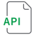
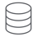
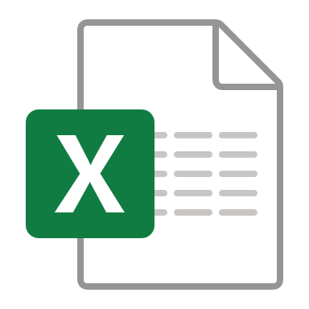





Business Objective - 1
Manel have grown organically, with disparate and siloed systems leading to operational inefficiency.
Cloud
Headquarters
E-commerce
Data Challenges
Real-time Sales Data
Data in multiple formats and platforms.
Data analysis is time consuming as data is not available in a central location
Data is not easily accessible to all users in the organisation.
On-prem POS Systems
London
Data Analysts
Retail stores
Paris
New York

Slide 9
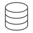

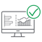
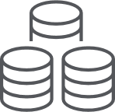


Proposed Solution – New data warehouse
Create the data foundation for operational efficiency.
Cloud
Headquarters
Data Challenge | Solution
Data in multiple formats and platforms. | Decommission APIs & flat-file input, and instead connect directly to source databases to extract real-time data
Data analysis is time consuming as data is not available in a central location | Create new data warehouse at the headquarters to centralize data storage and retrieval.
Data is not easily accessible to all users in the organization. | Create Data Marts and Data Products to make data accessible in a governed way.
E-commerce
Qlik Talend Cloud (CDC)
(MySQL)
On-prem POS System
Storage
Qlik Talend Cloud
(Transformation)
London
Qlik Talend Cloud (CDC)
Data warehouse
(PostgreSQL)
Data Mart automation?
Paris
Retail stores
Qlik Talend Cloud (CDC)
Business users
Data Marts
(PostgreSQL)
New York
Qlik Talend Cloud (CDC)
Data Products
Data Analysts
(PostgreSQL)

Slide 10
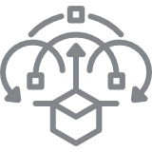


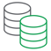
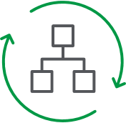
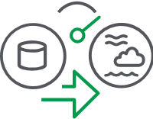
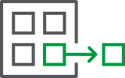

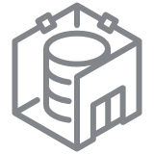
Medallion Architecture with Qlik Talend Cloud
Data warehouse creation
SOURCES
Qlik Talend Cloud
TARGETS
Snowflake
Dashboards
Cloud Applications
(E-Commerce)
MySQL
Data Ingestion
Change data capture
Bronze
Storage & History
Silver
Transformation
Gold
Data warehouse & Data Marketplace
Analytics & AI
platform
Near real-time capture of source data changes
Raw, unprocessed data
Data is stored as-is from various sources
Cleaned and validated data. Transformed, filtered and normalized.
Ready for analysis and business use. Contains aggregated and curated datasets.
Data Products
On-prem databases at Retail stores (POS London, POS New York, POS Paris)
PostgeSQL
Notes:
Things to highlight in the demo:
CDC
SQL AI assistant
Lineage

Slide 11
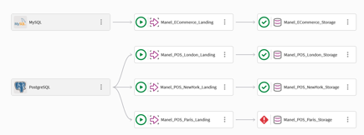
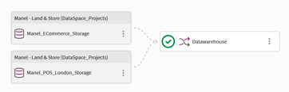
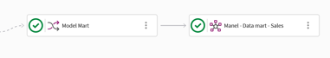
Full pipeline
Built using Qlik Talend Cloud’s data warehouse automation capabilities
Bronze
Storage & History
Silver
Transformation
Gold
Data Warehouse & Data Marketplace

Slide 12
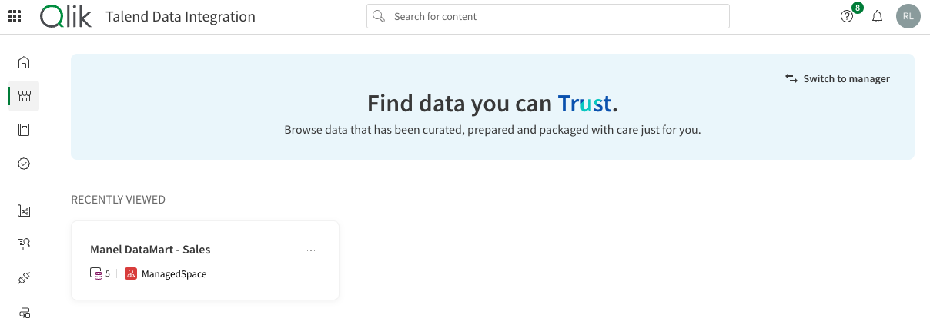
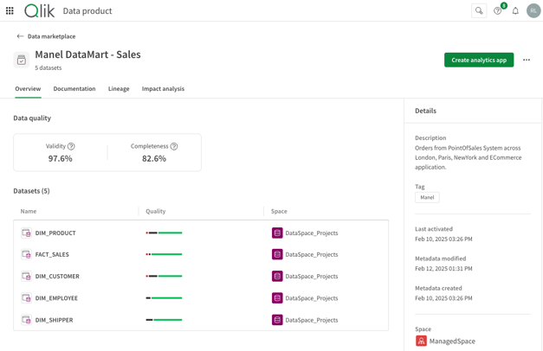
Data Marketplace

Slide 13
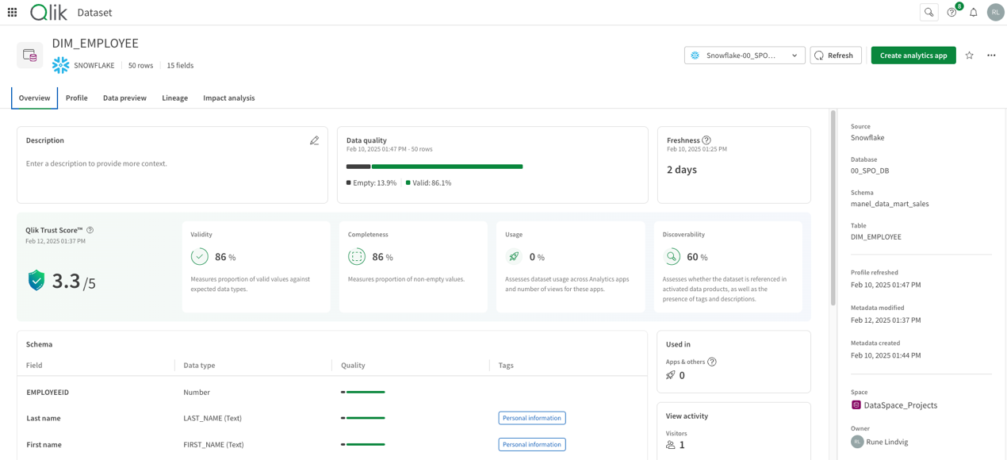
Data Marketplace

Slide 14
Demo execution steps

Slide 15
Demonstration steps for Use-case 1
Aerosmith: Walk this way... Talk this way
Data Marketplace
Explain the concepts of the marketplace
Data Product
Overview (Data Quality, ownership)
Documentation
Impact analysis– Show Analytic Report ( Associate engine, Insight advisor,)
Datasets
Trust Score
Data profile
Data preview
Data Lineage – Open Project from lineage
QTC Data pipeline walkthrough
Ingestion
Landing (CDC), Storage
Transformation
Transformation flow
SQL transformation with "SQL assistant"
Data modeling – Star Schema for data mart

Slide 16
Demonstration steps for Use-case 1
Detailed insights
Create database change
Run data changes (Talend job, API, SQL update)
Create orders or update product master data.
Data pipeline (Qlik cloud)
Show how data is replicated from Point-of-sale to Data Warehouse
Real-time and schedule
Data product (Qlik Marketplace)
Show how data products DQ can be refreshed
Dashboard (Qlik App)
Show data being updated in the Dashboard

Slide 17
Key Takeaways – Use case 1
Real-time CDC
Speed of Development
Datawarehouse automation
Data collaboration
Qlik Data Integration provides market-leading CDC capabilities and with ability to ingest data from nearly 200 sources.
Choose your flavor – No code/ Low-code or Pro-code.
Drag & Drop creation of data pipelines.
Easily define your star-schema data model
Enable SCD Type2 History with just a click of a check-box.
Bring the power of Qlik Analytics capabilities to your data warehouse.
Create a Data Marketplace to bringing your data producers and consumers in one place.
Build a trusted data foundation

Slide 18
Business Objective 2 Improve customer buying experience with Click-and-Collect services. Use case Real-time application integration

Slide 19
Business Objective 2
Improve delivery time & buying experience with a new Click-and-collect service
Cloud
Headquarters
Data Challenges
Places order
E-commerce
Send order to HQ
E-commerce system is not linked to local retail stores thus not taking advantage of location distribution
Data in multiple formats and platforms.
Data analysis is time consuming as data is not available in a central location
Data is not easily accessible to all users in the organisation.
Customer
Send email / text confirmation with code for pick-up
On-prem POS System
London
Collects at Store
Data warehouse
Paris
Real-time inventory kept in synch
Retail stores
New York
Notes:
API med Inventory fra headquarter. (alle systemer kan slå op). API med ordre, som routes til det pågældende POS system.

Slide 20

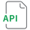

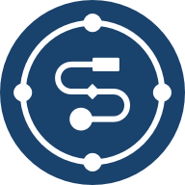
Use case: Application Integration
Click-and-Collect - Immediate order pickup from local stores.
Cloud
Headquarters
Data Challenge | Solution
Ecommerce store and retail-stores applications are not integrated. | Create REST APIs using Talend to integrate applications.
Enhance customer experience by providing real-time connectivity and synch between e-commerce and retail outlets. | Create a pub-sub messaging architecture with Talend and Kafka
Publish to Kafka
Write to
database
E-commerce
User interface
Landing
Talend Studio implements REST API
(MySQL)
On-prem POS System
Qlik Talend Cloud (CDC)
London
Storage
Qlik Talend Cloud (CDC)
Data warehouse
Paris
(PostgreSQL)
Warehouse automation
Retail stores
Qlik Talend Cloud (CDC)
Subscribe to Kafka
Qlik Talend reads Kafka messages and routes to retail store
Data Marts
(PostgreSQL)
New York
Qlik Talend Cloud (CDC)
Data Products
(PostgreSQL)
Notes:
[Talk Track]
Phase 2 – Improve the customer buying experience by implementing Click-and-collect. This allows the customer to place an order on the e-commerce site. The website can query the inventory at the local store, and if stock is available, it can be reserved for pick-up by the customer within a few hours.
This is possible by creating REST APIs using Talend API services that allows the e-commerce system and the POS system to communicate with each other.

Slide 21
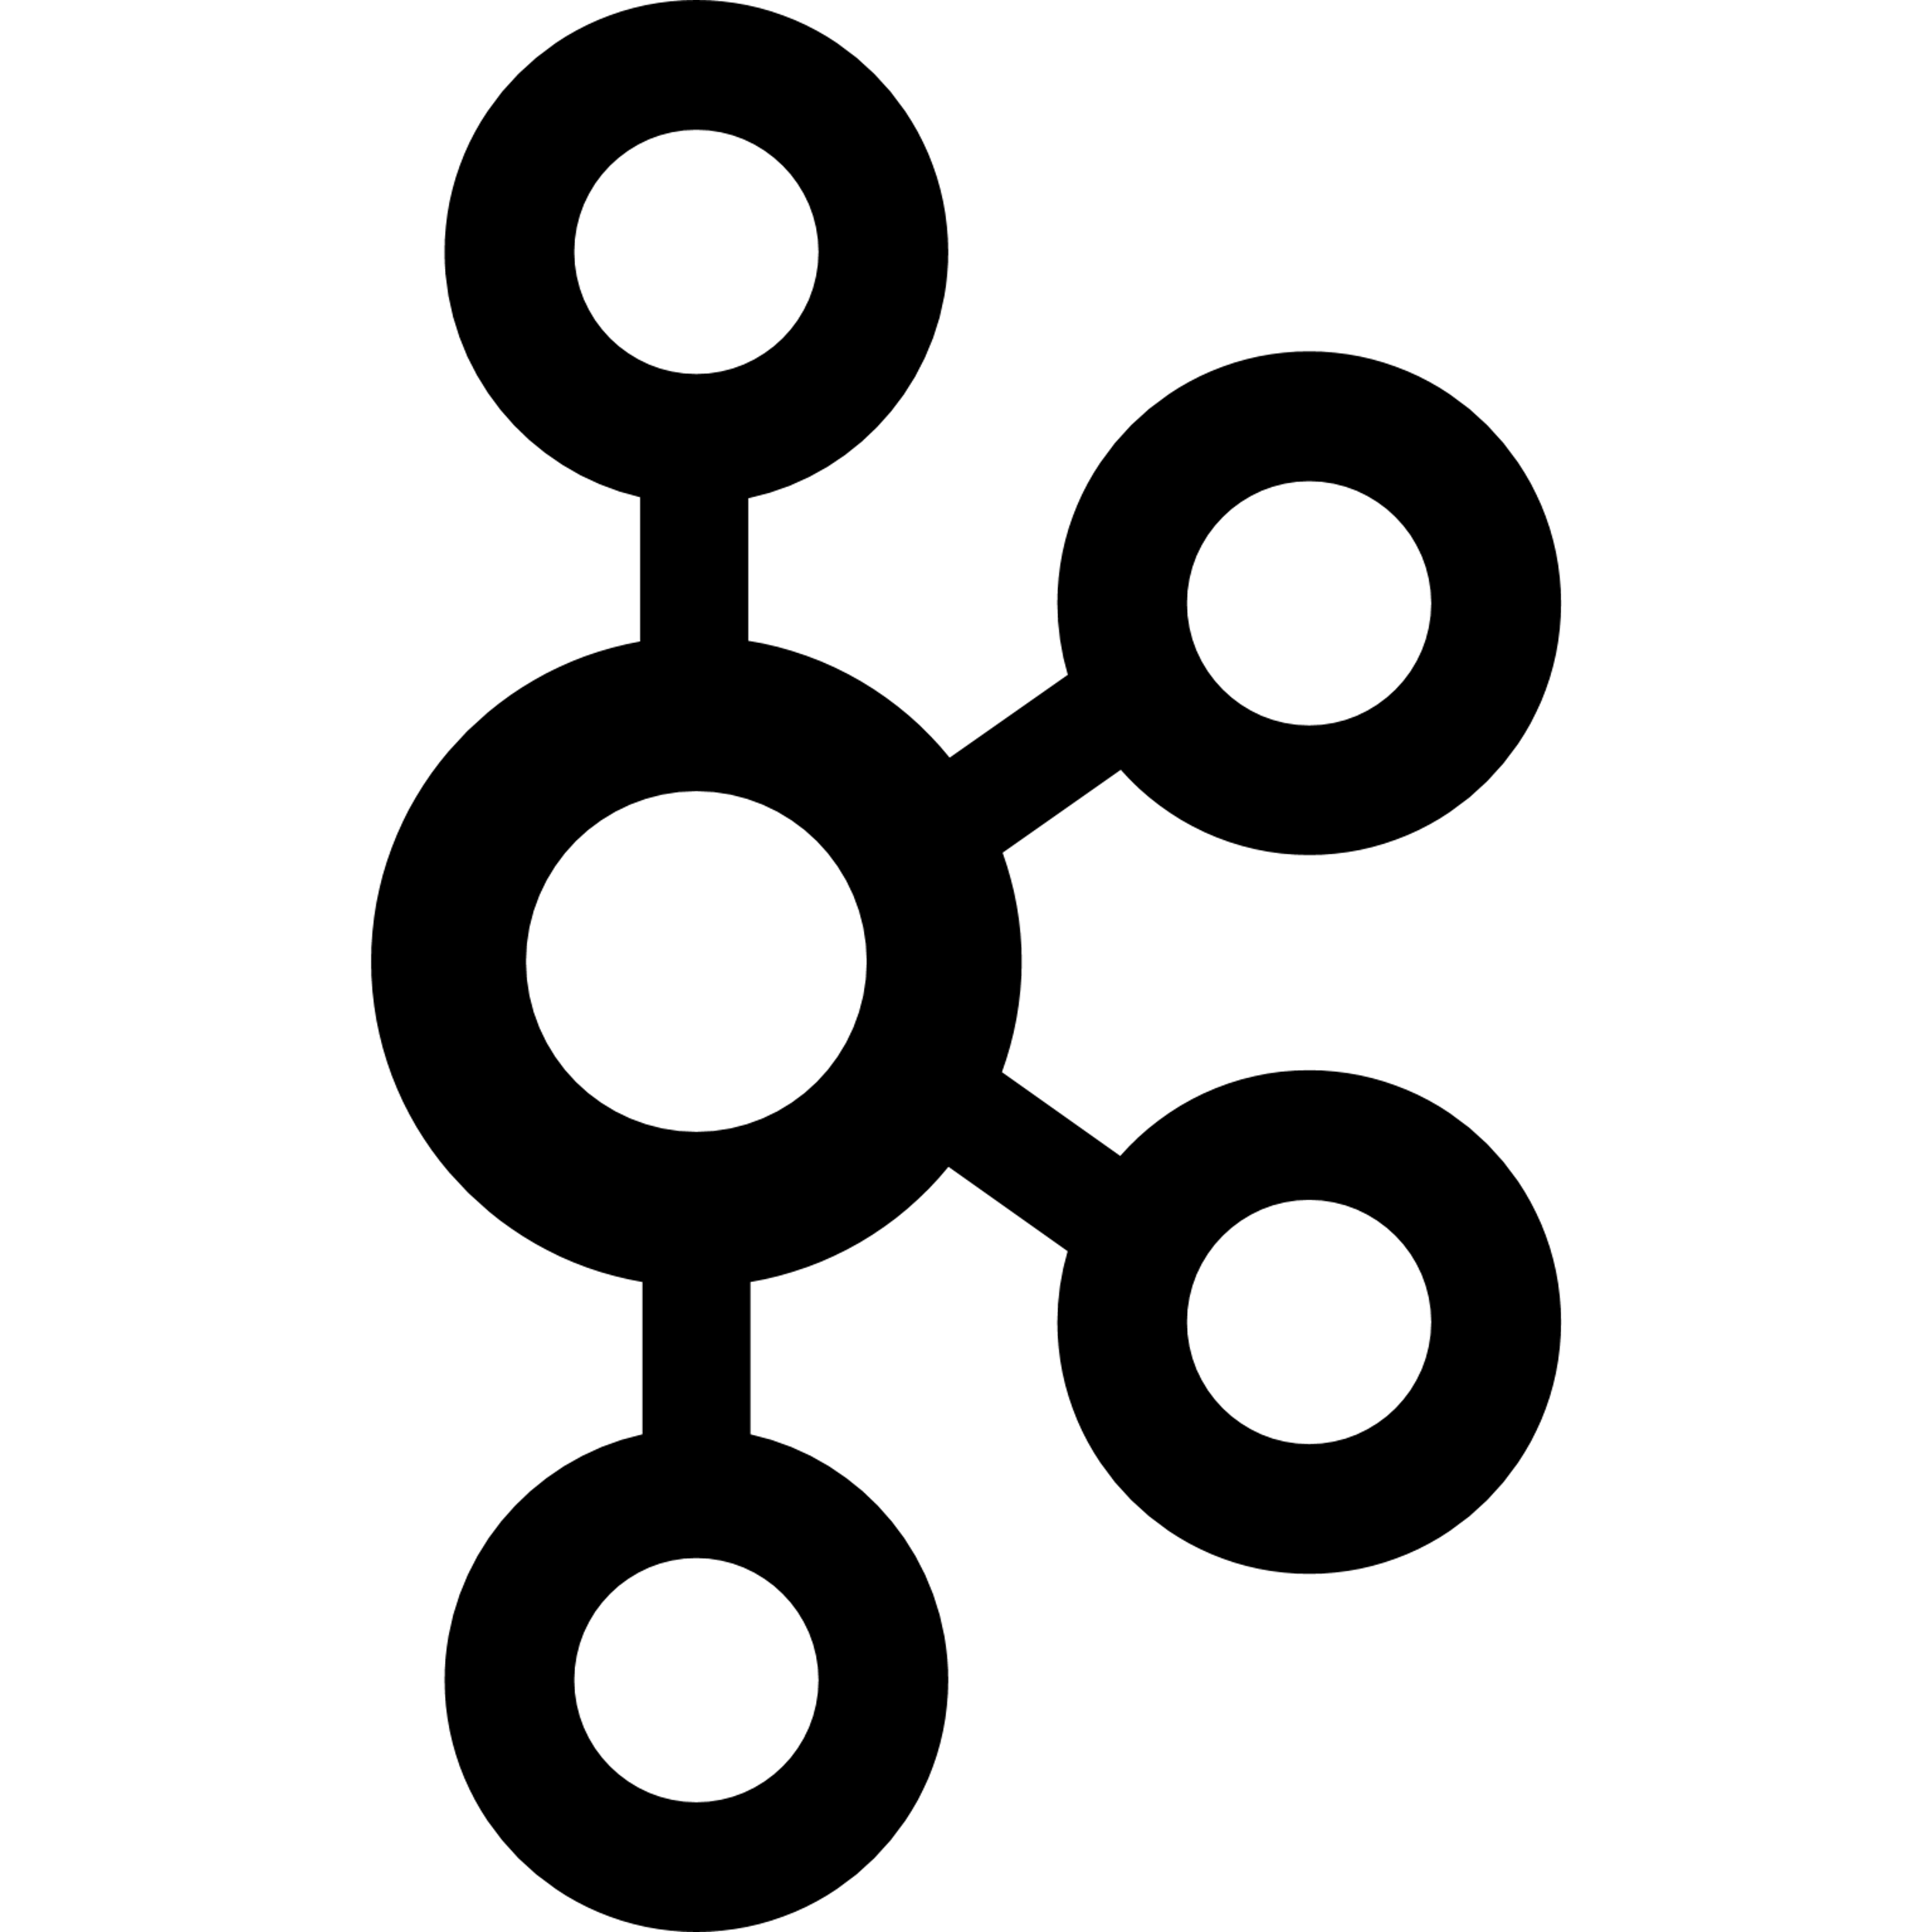

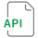

Medallion & Event-driven Architecture with Qlik Talend Cloud
Data warehouse & Application Integration
SOURCES
Qlik Talend Cloud
TARGETS
Snowflake
Data Ingestion
Change data capture
Bronze
Storage & History
Silver
Transformation
Gold
Data warehouse & Marketplace
Dashboards
Cloud Applications
(E-Commerce)
MySQL
Analytics & AI
platform
Near real-time capture of source data changes
Raw, unprocessed data
Data is stored as-is from various sources
Cleaned and validated data. Transformed, filtered and normalized.
Ready for analysis and business use. Contains aggregated and curated datasets.
Notification
Email
Data Products
Data Ingestion
Event streaming
Integration
Process Messages
Distribution
Call REST APIs
On-prem databases at Retail stores (POS London, POS New York, POS Paris)
Postgresql
Near real-time capture of source data changes
Consume messages and process it efficiently
Push data to POS systems.
Integrate with notification systems
Notes:
Things to highlight in the demo:
CDC
SQL AI assistant
Lineage

Slide 22
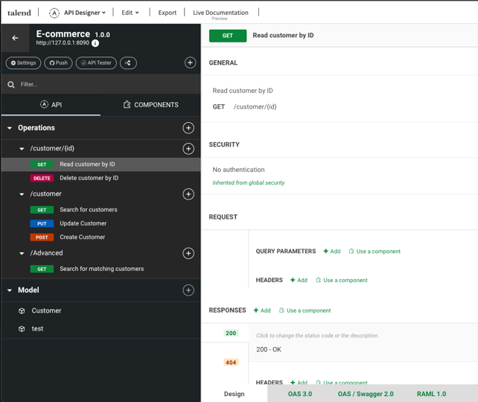
API Designer
Define API contract to Ecommerce application

Slide 23
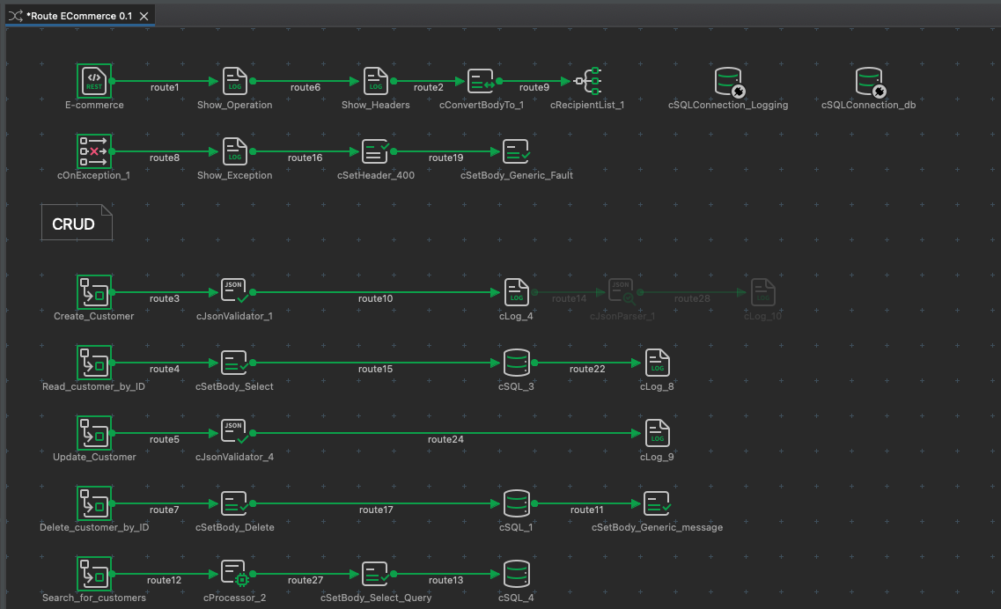
API Implementation
Define data & transformation flow for API

Slide 24
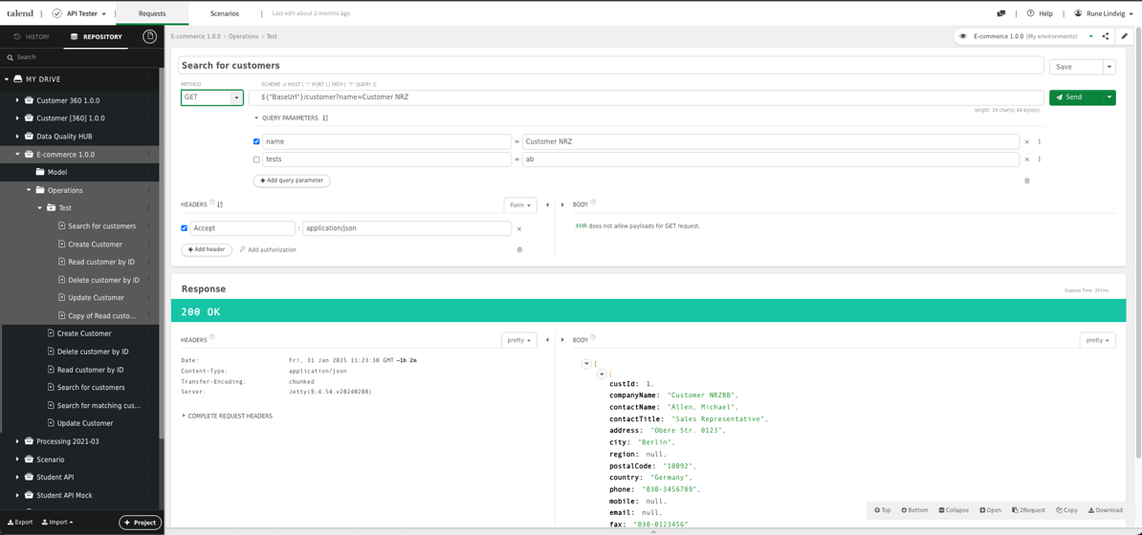
API Tester
Scenario test API

Slide 25
Demonstration Use-case 2 execution steps

Slide 26
Demonstration steps for use-case 2(see video)
Show the implementation
API
Insert or update a master item e.g. product.
QTC
Real time streaming pipeline to Kafka
Studio
Show distribution route

Slide 27
Key Takeaways – Use case 2
Business process orchestration
Real-time application integration
De-coupled systems
Single data-platform
Automate and integrate core business processes to deliver more real-time value.
Talend acts as the integration layer – consuming, processing and distributing events.
Talend provides the ability to build and consume APIs.
Using an event-driven architecture allows for scalable, high-volume event driven workloads.
Increased responsiveness due to asynchronous event processing.
Qlik provides the best tools for every integration pattern – ETL, ELT, CDC, API and EDA
Build a trusted data foundation

Slide 28
Demo-package Technical overview

Slide 29
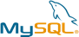
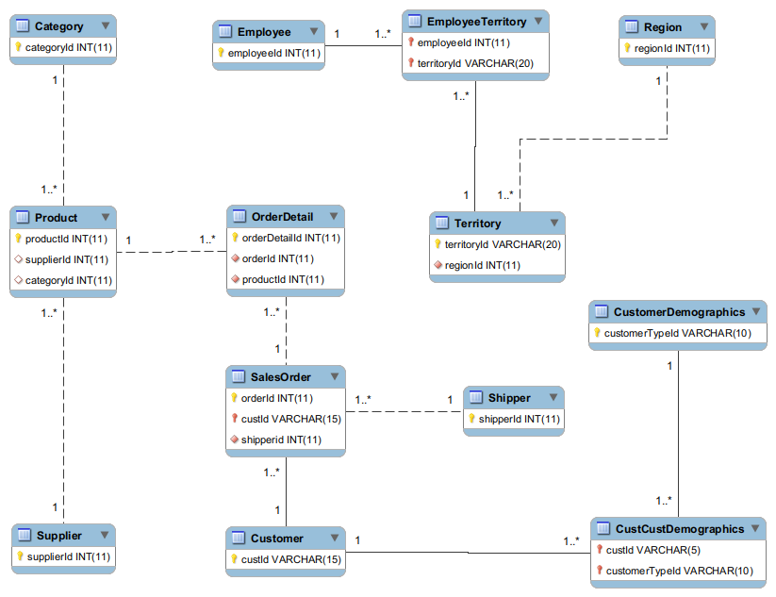
Data Model ECommerce

Slide 30

Data Model POS

Slide 31
Demo-package Installation steps

Slide 32
Installation & Configuration
GitHub desktop - https://github.com/apps/desktop
Download & install
Clone repository https://github.com/Volle72/PartnerRepository
Qlik Talend NFR - https://login.qlik.com
Check your tenant has the right license/product access
Install and configure a Data Movement Gateway on RedHat compatible distribution except for Docker option 1
Databases & Engines (MySQL, Postgres, Kafka, Qlik Gateway, Talend remote Engine) Pick any one option from below (arranged from easy to difficult)
Option 1 – Docker Desktop
Option 2 - AWS or Azure hosted
Option 3 – VirtualBox (Ubuntu server)
Target (Cloud Database) - Snowflake

Slide 33
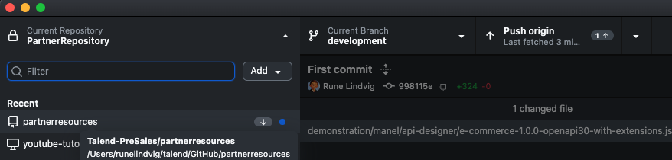
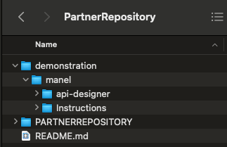
GitHub Use GITHub desktop or CLI to download all demo assets
GitHub Desktop
Pull GITHub Image with CLI
Initialize
mkdir /GITHub/PartnerRepository
git init
Pull image
git pull REMOTE-NAME BRANCH-NAME # Grabs online updates and merges them with your local work git pull https://ghp_xToken@github.com/Volle72/PartnerRepository main

Slide 34
Qlik Talend NFR

Slide 35
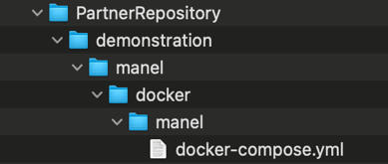
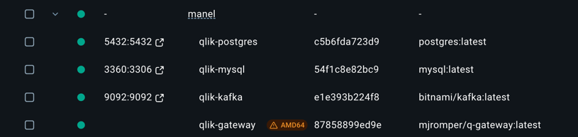
Docker Environment
Download and install Docker desktop https://docs.docker.com/desktop/
Run Docker-Compose command
Change the entry to your NFR in file docker-compose.yml - TENANT_NAMEREGION=yourNFRtenant.region e.g. yk72iv0ghhetdyrml.eu
Go to directory "../manel/Docker" and execute
Docker-compose up –d (Creates all containers)
Docker-compose start|stop|down (down:to destroy the containers, start: starts containers, stop: stops container)
This will setup Postgres, MySQL, Kafka and Qlik Data Management Gateway

Slide 36
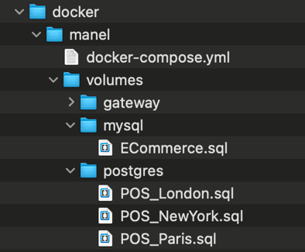
Setup databases and gateway
Run script Ecommerce.sql on Mysql database
docker exec -it qlik-mysql /bin/bash
mysql -u root -pmy-secret-pw
source /opt/qlik/ecommerce.sql
Run script POS.sql on Postgresql database
docker exec -it qlik-postgres /bin/bash
psql -U pos_user -d POS -a -f /opt/qlik/POS_London.sql
psql -U pos_user -d POS -a -f /opt/qlik/POS_Paris.sql
psql -U pos_user -d POS -a -f /opt/qlik/POS_NewYork.sql
Get Qlik Data Movement Gateway token
You can retrieve the Qlik gateway key from container log or the file key.json
docker exec -it qlik-gateway /bin/bash
cat /app/key.json
Notes:
Docker volume ls
Docker volume rm manel_msdata
Dcoker volume rm manel_pgdata

Slide 37
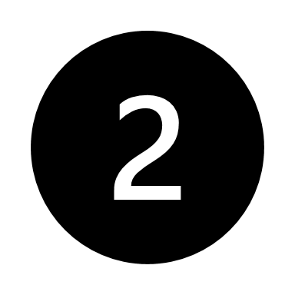
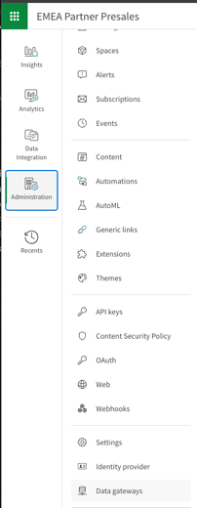
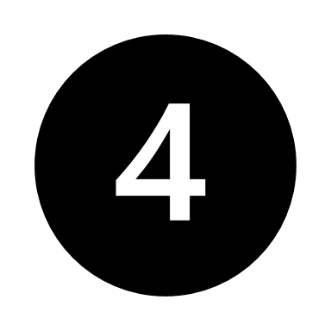
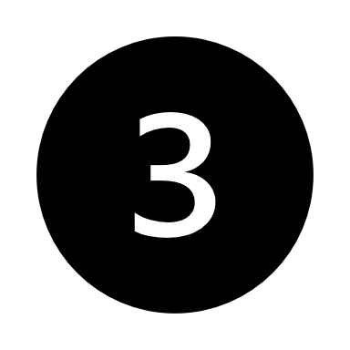
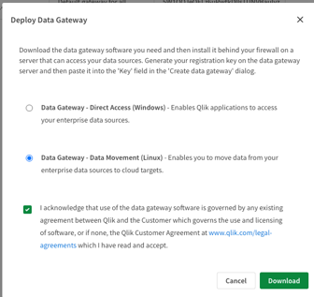
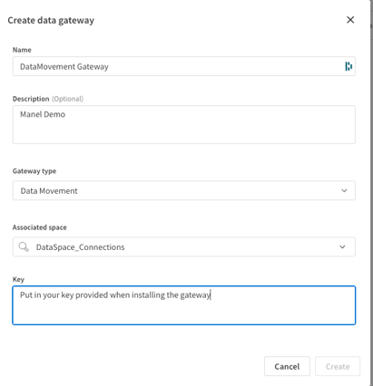

Setup Gateway
Notes:
Copy the downloaded rpm file to gateway linux server
Steps example
Mkdir /qlik/Gateway
cd /qlik/Gateway
cp /downloadLocation/xxxxxx.rpm .
sudo QLIK_CUSTOMER_AGREEMENT_ACCEPT=yes rpm -ivh qlik-data-gateway-data-movement.rpm
cd /opt/qlik/gateway/movement/bin
./agentctl qcs set_config --tenant_url mytenant.us.qlikcloud.com
./agentctl qcs get_registration

Slide 38
Qlik Talend Cloud
Create 4 Spaces:
DataSpace_Connections (Place all connections here)
DataSpace_Projects (Place integration pipelines here)
ManagedSpace (Governed space for Analytics)
SharedSpace (Used to develop apps collaboratively and control access to apps.)
Configure Gateway (Data Movement)
Create Connections:
Snowflake database (Target)
Mysql(Source)
Postgres (Source)
Import Projects from provided in GIT into “DataSpace_Projects”

Slide 39
Talend Cloud
Configuration steps
Aquire License (Tenant)
Create GIT account and setup repository | Add a GIT repository and definte token
Add Project | Associate GIT endpoint to project, Assign users to project
Add Environment | Define Development, Test, Product
Add Workspace | Add/associate workspace(s) to environement
Define Promotion | Dev-->Test-->Production
Download in install Studio | Login via Cloud and connect to GIT via GIT Token
Optional
Add Engine | Add engine and assign to environment
Install engine on server | Pair with the token from cloud engine definition
Pending

Slide 40
Thank you

